Slide 1
How to simulate Quantum computing on Classical computing
7/8/2021

Slide 2
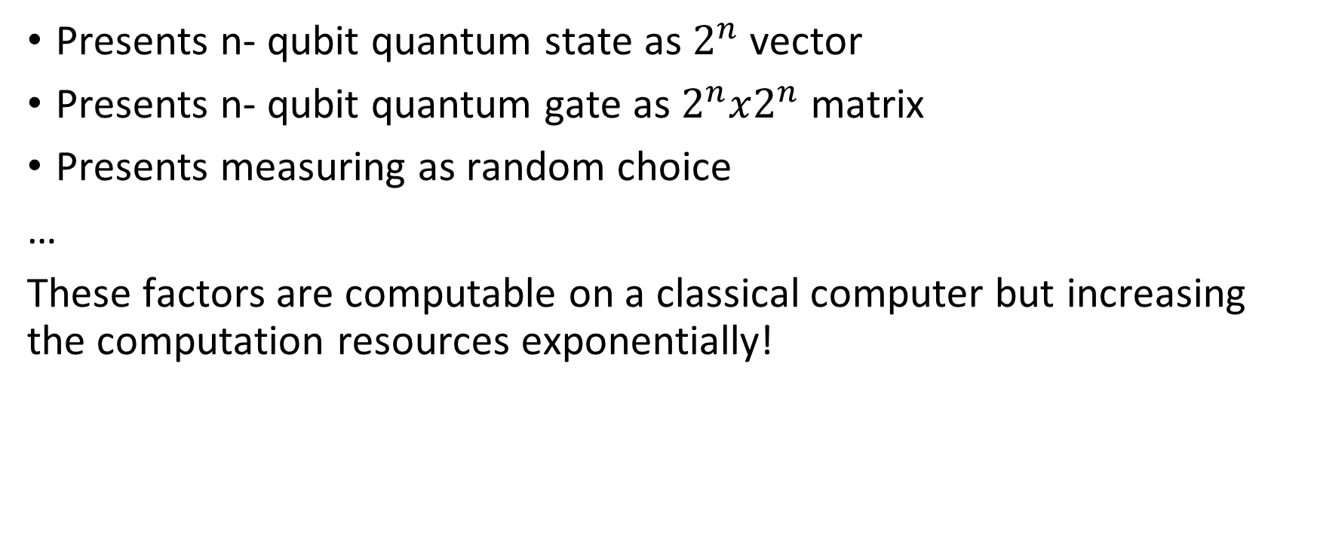
1. Ideal
Presents n- qubit quantum state as $2^{n}$vector
Presents n- qubit quantum gate as $2^{n}x2^{n}$ matrix
Presents measuring as random choice
…
These factors are computable on a classical computer but increasing the computation resources exponentially!

Slide 3
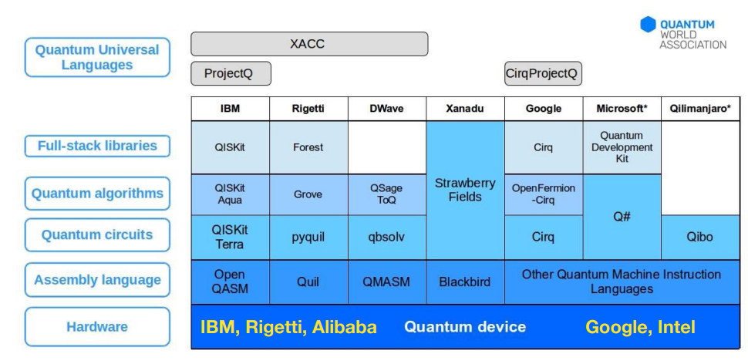
2. Quantum language

Slide 4
2. Quantum language
Language: C, C++, Lisp, Coq, Python, F#, Haskell (Functional)
Typical simultors: Qiskit, Q#, ProjectQ, QVM, Qulac, Qsun (VNU), …
Tutorials: qiskit.
Book:
Quantum computing for Computer scientist
Nhập môn máy tính lượng tử

Slide 5
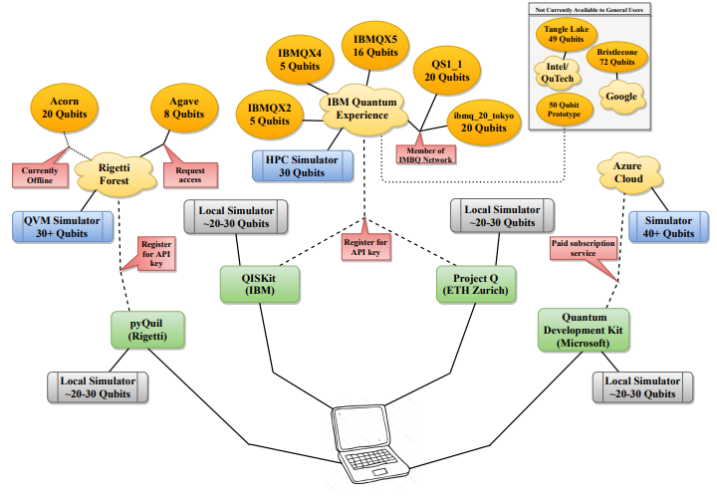
3. Limited

Slide 6
4. Practice / simulate
from qiskit.aqua.algorithms import Shor
from qiskit.aqua import QuantumInstance
from qiskit import Aer
key = 15 # Number that need factor
base = 2
back_end = Aer.get_backend('qasm_simulator')
q = QuantumInstance(backend = back_end, shots = 1024)
shor = Shor(N = key, a = base, quantum_instance = q)
results = shor.run()
print(results['factors'])

Slide 7
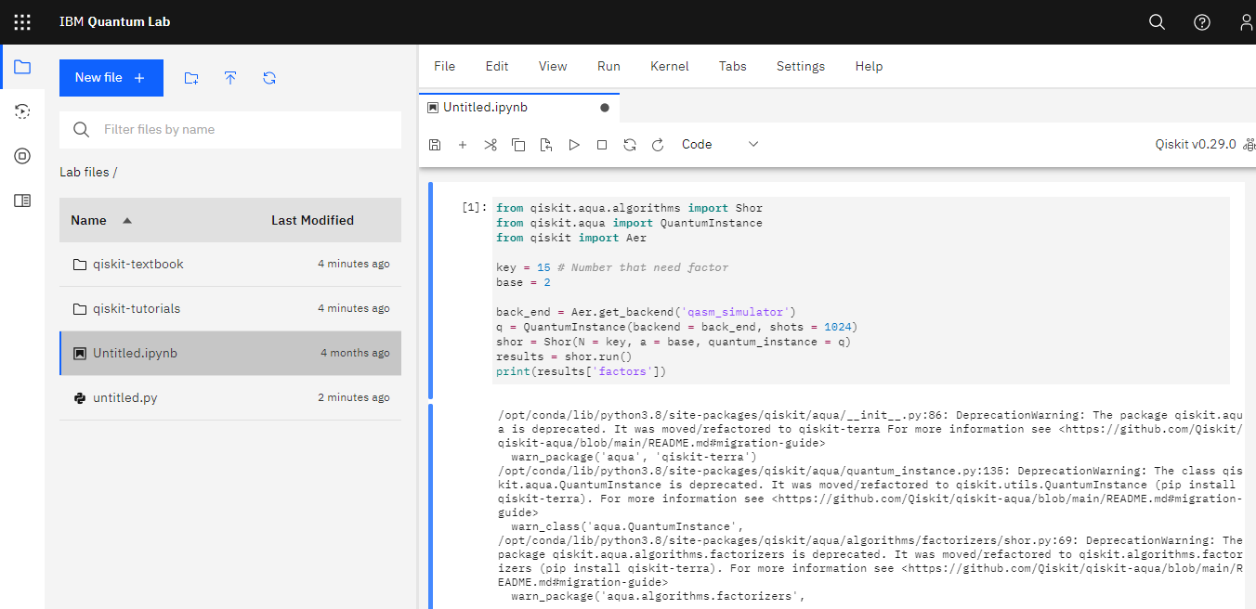
4. Practice / cloud service https://lab.quantum-computing.ibm.com/

